Slide 1
Apache Tika

Slide 2
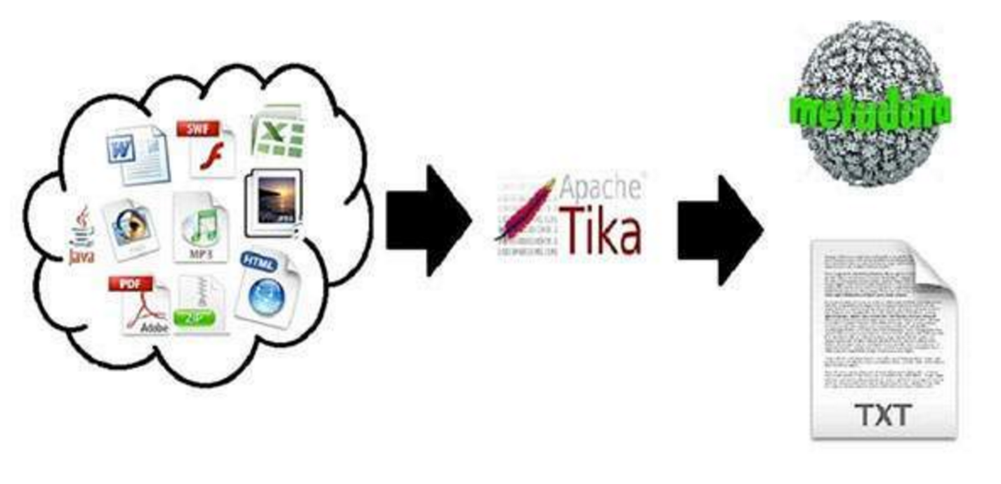
What is Tika?
Document type detection
Content Extraction

Slide 3
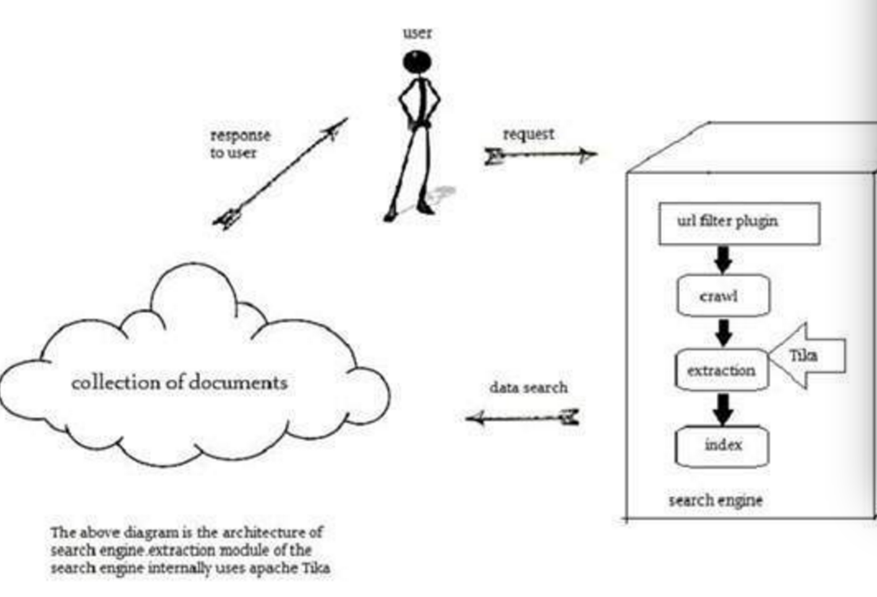
Applications of Tika
Search Engine
Document Analysis
Digital Asset Management
Content analysis

Slide 4
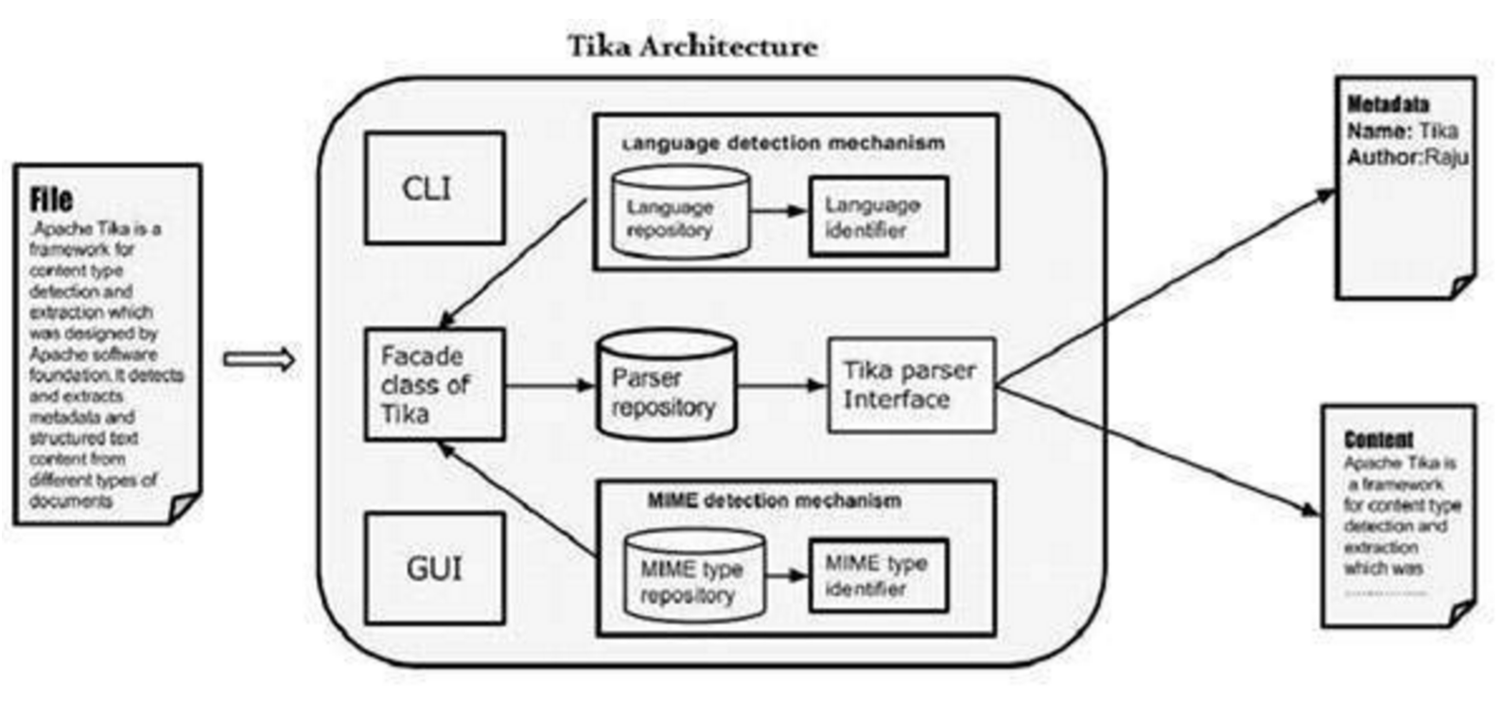
Architechture

Slide 5
Components
Language Detection Mechanism (org.apache.tika.language)
MIME Detection Mechanism (magic bytes, character encoding)
Parser Interface (Parser logic)
Tika Façade class (Jav)

Slide 6
Demo

